Slide 1
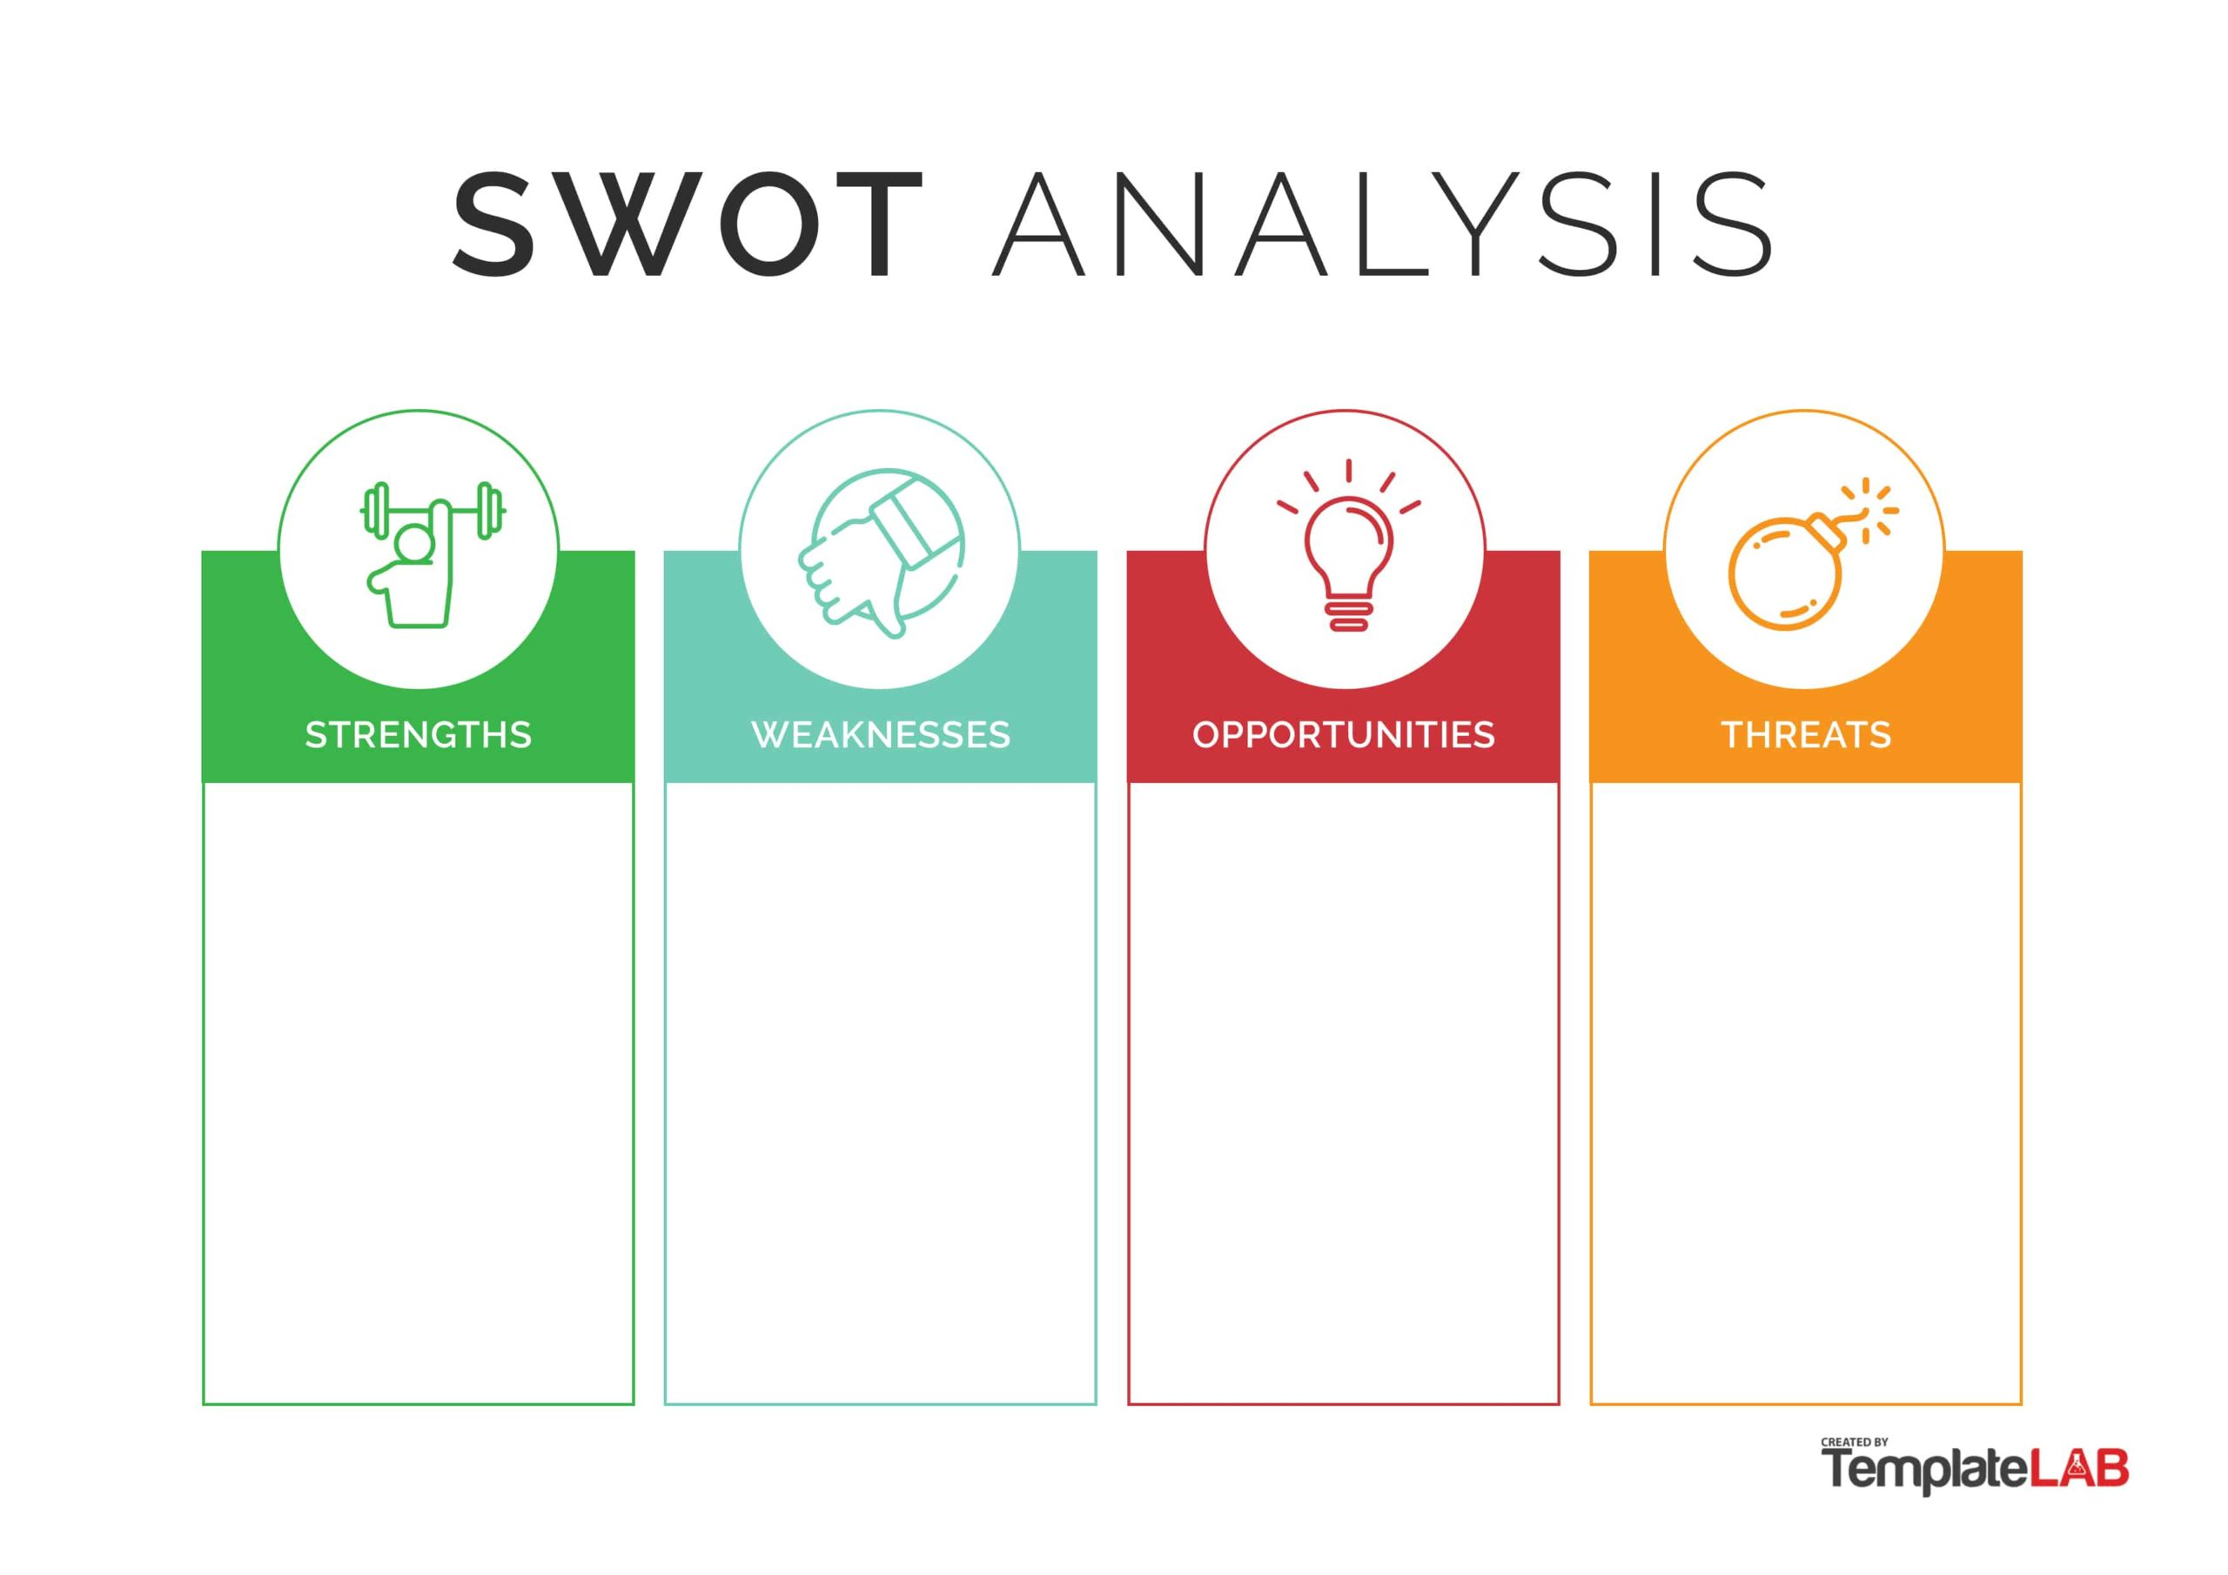
-Capable to make a website
-Good with coding
-Lots of inspo.
-
-People can require my services
-Create a business card
-Publicity
-Tech failure
-

